Slide 1


Version control
Georg Heiler CSH 2020 | GIT101
Portions of this lecture were developed for the OpenDS4All project,
piloted by Penn, IBM, and the Linux Foundation
https://github.com/odpi/OpenDS4All and derivative work of
University of Pennsylvania's CIS 545, Big Data Analytics
https://sites.google.com/seas.upenn.edu/cis545
Notes:
Mention source material

Slide 2
Basics
unix

Slide 3
Reproducible = repeatable = automated = scripts = terminal (regardless of OS, linux will be discussed)
http://www.informit.com/blogs/blog.aspx?uk=The-10-Most-Important-Linux-Commands
ls
cd
man
mkdir
rm
locate
Commandline text editor vim /emancs (when working on remote servers)
Data science in the shell https://blog.robertelder.org/data-science-linux-command-line/
Notes:
Open up link for DS in shell

Slide 4
VersIon Control
GIT

Slide 5
Kinds & attributes of version control & locking
Local / distributed
Optimistic / pessimistic

Slide 6
installation
https://git-scm.com/
Your package manager of choice
Linux: apt install git (Ubuntu)
Windows: choco install git (https://chocolatey.org/packages/git)
Mac: brew install git

Slide 7
Workflow
Project
Server

Slide 8
What is it?
distributed version control
needed to keep a log of changes and synchronize across the team
See the demo and try it online
great and free GUI
https://www.sourcetreeapp.com/
Visual studio code
Notes:
Open the link https://learngitbranching.js.org/?demo

Slide 9
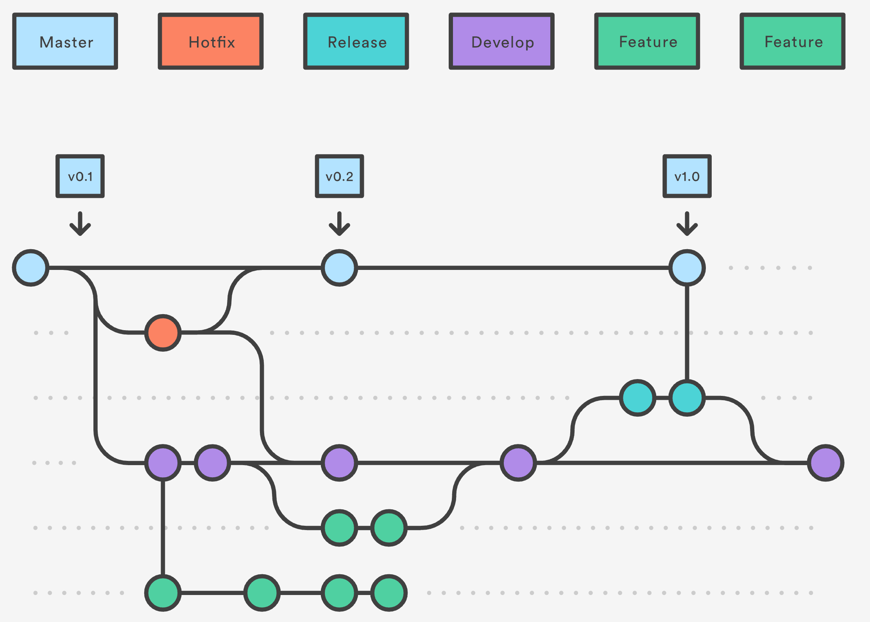
Git flow

Slide 10
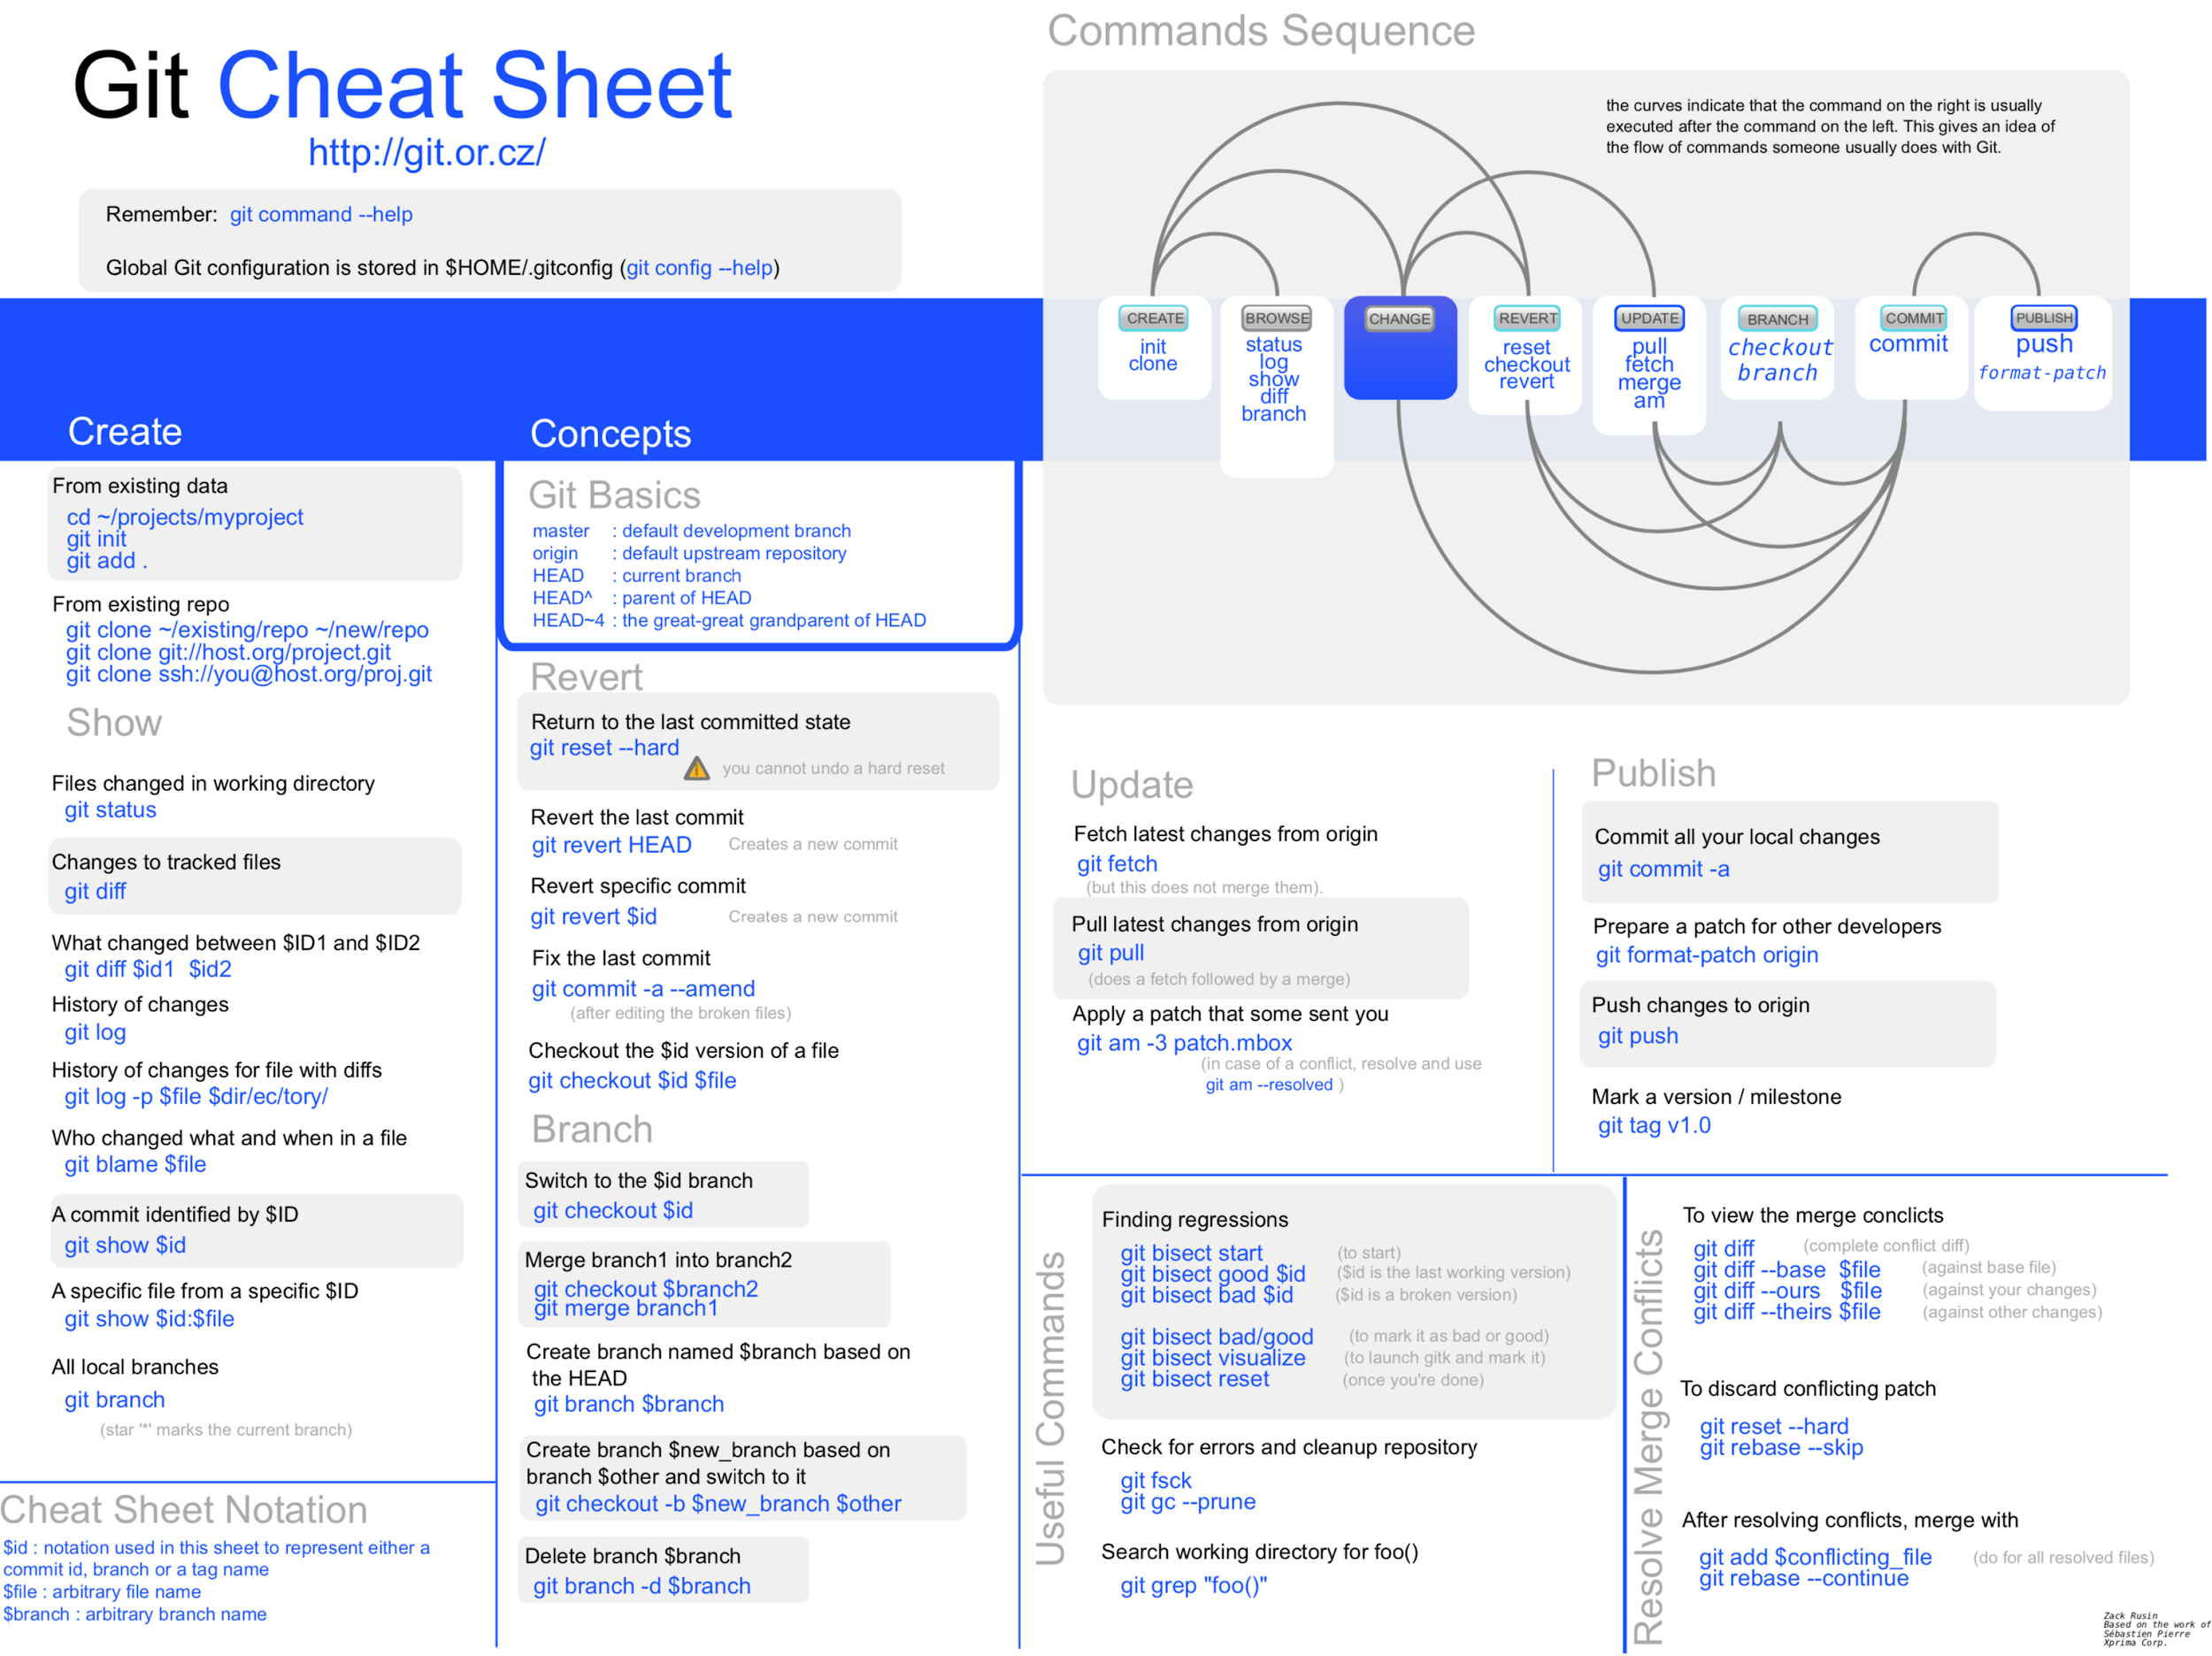

Slide 11
DEMO
Please follow along to https://github.com/complexity-science-hub/skillup-GIT101-2020-demo
Notes:
initialize repository. |||||||||| check time, ask who already knows
commit things
merge and branch
resolve conflicts

Slide 12
Reference material
https://guides.github.com/introduction/git-handbook/
https://lab.github.com/githubtraining/introduction-to-github
https://try.github.io/

Slide 13
Future topics
https://docs.google.com/spreadsheets/d/1ALgZvOueCLeghxbLk6kza-3STkSuvCLFp3BQ-rB-F5Q/edit#gid=0
https://github.com/complexity-science-hub/skillup

